Slide 1


AHD
Consult
MedLab Diagnostic
Operations
Strategy
Date of Presentation: July 10, 2025

Slide 2

Understanding MedLab’s Business?Operations
Focus: Test types, demographics, operations.
Insights: Test popularity, turnaround, revenue, peak periods, referrals.
Goal: Data-driven decisions for efficiency and service quality.
Problem Statement Challenge: MedLab Diagnostics in Kumasi struggles with patient retention and operational inefficiencies.
Issues: Uneven revenue, imbalanced demand, and underutilized services.
Impact: Hinders growth and resource use.
Solution: Data insights to improve retention, operations, and revenue.
Project Overview Analysis: Power BI project analyzes MedLab Diagnostics’ patient testing data.
AHD
Consult

Slide 3
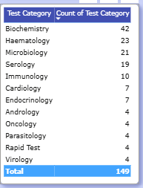
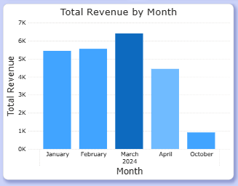
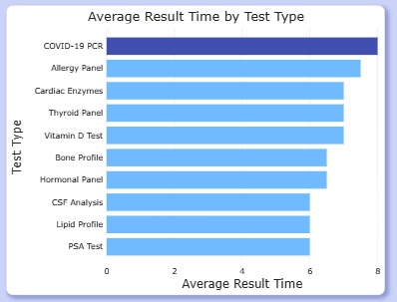
Key Insights
AHD
Consult
Total Revenue by Year and Month
Average Results Time by Test Type
Count of Test Category
March recorded the highest revenue, peaking 7k
October saw the lowest performance, with revenue barely reaching 1K.
COVID-19 PCR had the highest average result time among all test types.
PSA Test had the shortest average result time, indicating quicker turnaround.
Biochemistry had the highest number of tests, totaling 42 out of 149.
Virology and Rapid Tests were the least conducted, with only 1 test each.

Slide 4
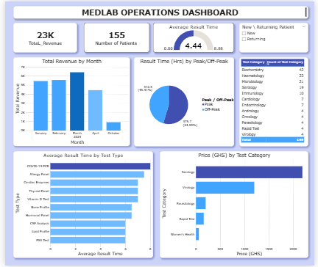
Medlab Diagnostic Dashboard
AHD
Consult
Trends and Patterns:
Revenue peaked in March but declined in April.
155 patients served, with a mix of new and returning patients.
Average result time is 4.44 hours, with more tests processed during off-peak hours.
Biochemistry tests are the most frequent; COVID-19 PCR tests take the longest to process.
Serology tests are the most expensive, while women’s health tests are the least expensive.
VIEW DASHBOARD HERE
Visualization

Slide 5
AHD
Consult
Recommendation
Increase revenue per patient through peak-hour staffing and targeted test promotion.
Use dashboards and patient feedback to enhance operations and service quality.
Re-engage patients with loyalty programs, reminders, and bundled wellness packages.
Improve turnaround for slow tests while maintaining speed in quicker ones.
Focus resources on high-demand tests and evaluate low-volume test costs
Focus marketing and operations on Q1 to boost revenue, and analyze the October decline to prevent future drops.

Slide 6
Conclusion
By aligning resources with demand, improving test turnaround times, and strategically engaging patients, the organization can enhance service quality, increase patient retention, and maximize revenue growth.
AHD
Consult

